Slide 1
Admiral IT Fantasy League
Week 1 Tuesday Morning QB

Slide 2
Scores
Team 1 | Score | Record | Team 2 | Score | Record
Team Rosie (RGM) | 114.7 | 1-0 | Kerryon My Wayword Son (KS) | 114.5 | 0-1
Haddonfield Cheetahs (HC) |  |  | Colorado Tegridy Farms (CTF)
Team Pinder (PIND) |  |  | Team Brian (R) | 140.5
Dumpster Fires (Wtf) |  |  | Team Laskowski (LASK)
Philly Pretzels (PHLP) |  |  | Marlton Analytics (Pi)

Slide 3
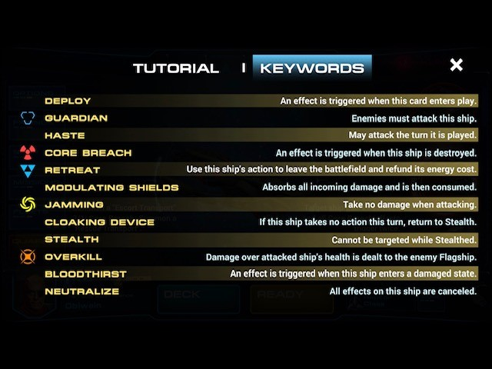
Standings
One
Two
Three
Four
Five
Six
Seven
Eight
Nine
Ten

Slide 4
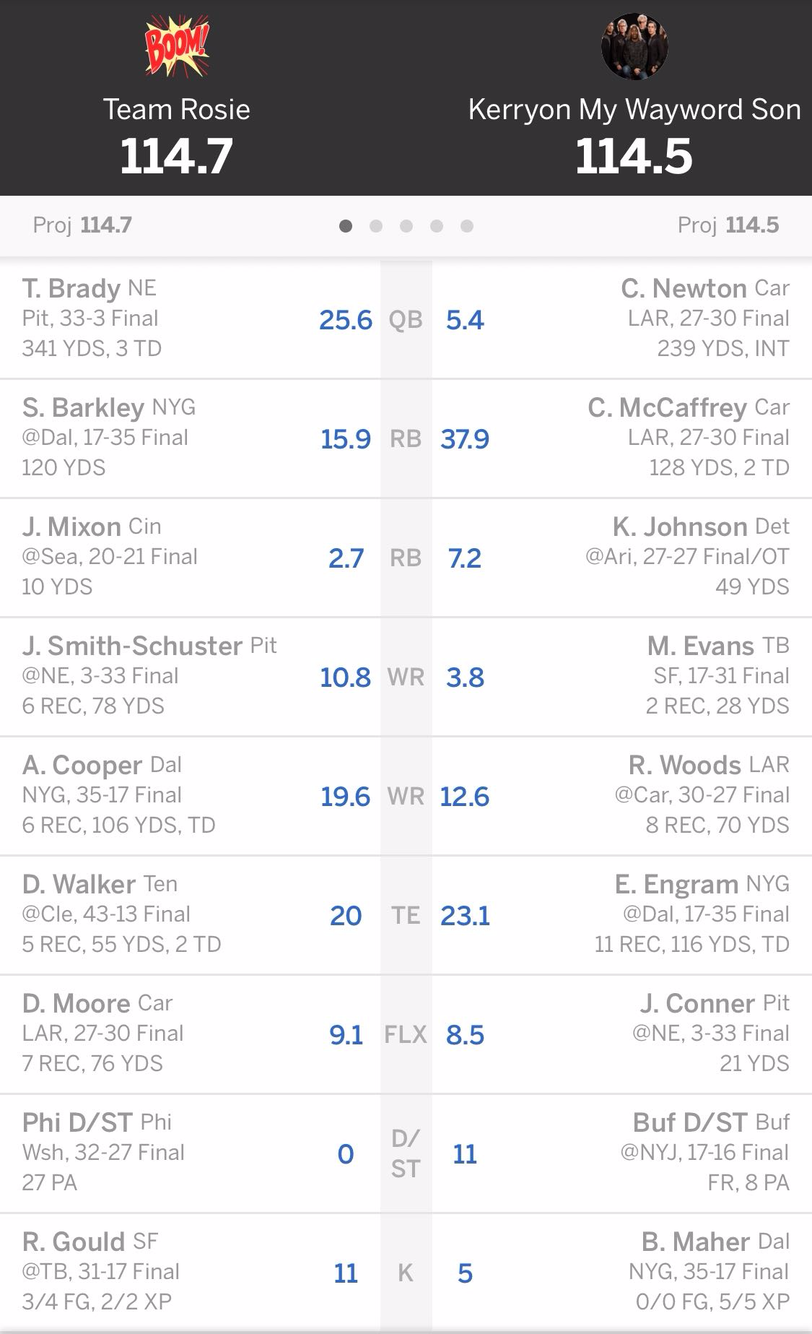

Tale of the Tape
Team Rosie (RGM) vs Kerryon My Wayword Son (KS)
A tightly contested matchup throughout the day was settled by a meaningless ten yard catch by Smith-Schuster during junk time. Both RGM and KS had some notable bench performances in DeSean Jackson and T.Y. Hilton, respectively. A little bit of Karma may have played into this 2/10th of a point loss for KS, as well.
Notable week 1 Breakouts:
RGM
Delanie Walker
KS
Christian McCaffrey
Evan Engram
Notable week 1 Busts:
RGM
Joe Mixon
Eagles D/ST (lol)
KS
James Conner
Mike Evans
Kerryon Johnson

Slide 5
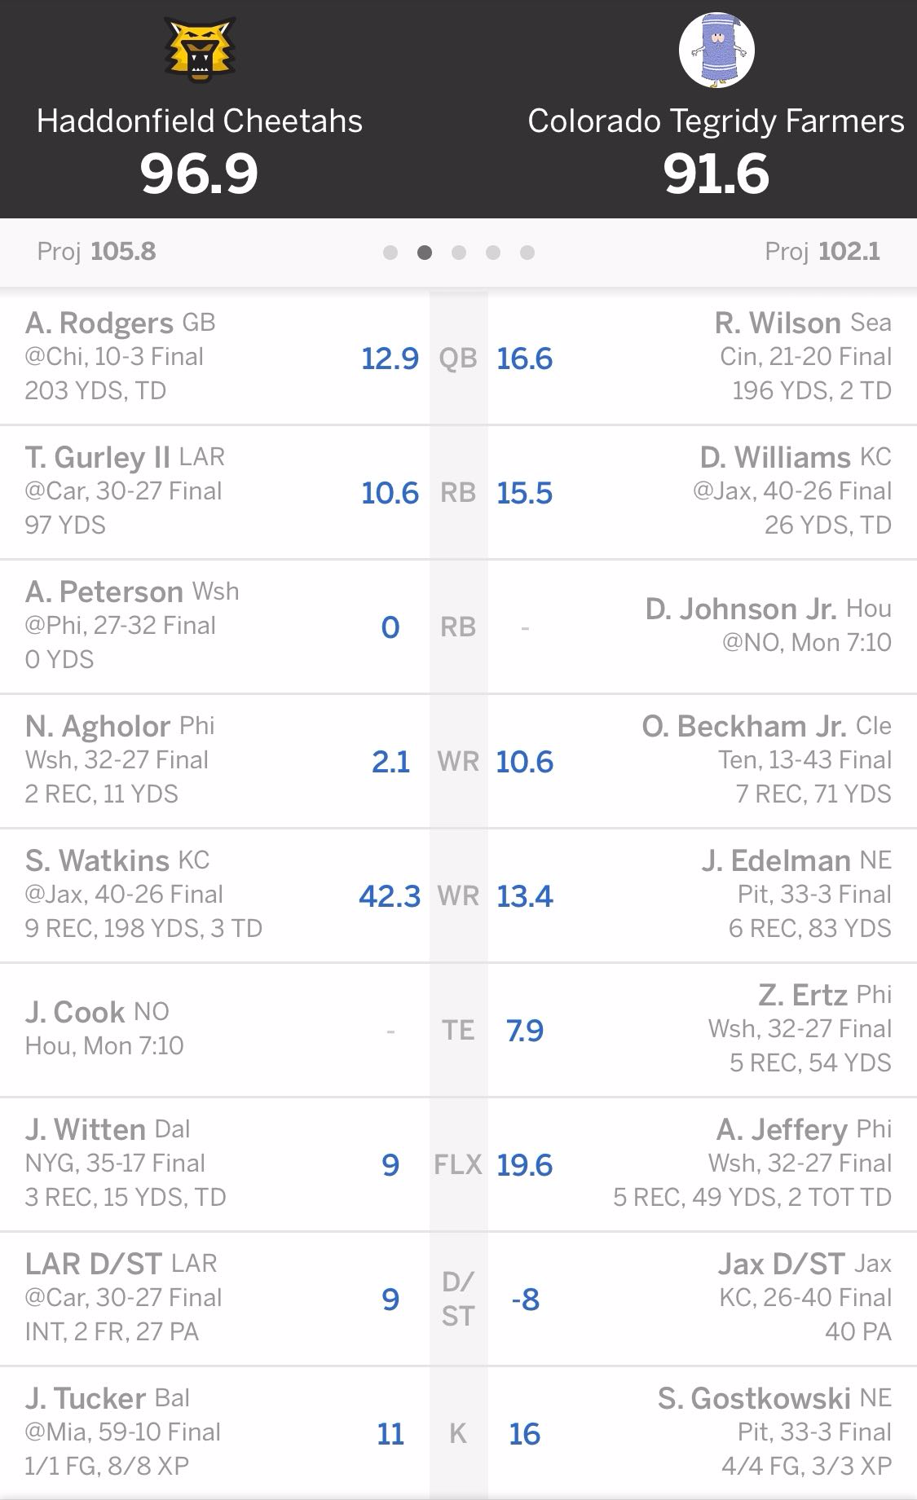
Tale of the Tape
Haddonfield Cheetahs (HC) vs Colorado Tegridy Farms (CTF)
Despite the Washington Redskin’s best effort to hamstring the Haddonfield Cheetahs with a last minute deactivation of Adrian Peterson, Sammy Watkins stepped up early to carry this team to what seemed like a sure-win in the 1 o’clock slot. However, in typical Eagles form, it took them a full three quarters to get warmed up and pull CTF back into this contest. In addition, it seems that CTF may have learned a valuable lesson to never start a defense against the Kansas City Chiefs.
Notable week 1 Breakouts:
HC
Sammy Watkins
CTF
Stephen Gostkowski
Notable week 1 Busts:
HC
Aaron Rodgers
Todd Gurley
Nelson Agholor
CTF
Zach Ertz
Odel Beckham Jr
Jaguars D/ST

Slide 6
Tale of the Tape
Team 1 vs Team 2

Slide 7
Tale of the Tape
Team 1 vs Team 2

Slide 8
Tale of the Tape
Team 1 vs Team 2

Slide 9
Tale of the Tape
Team 1 vs Team 2

Slide 10
Trade Summaries

Slide 11
Picks that Paid Off

